Slide 1
TARIFFS AND THE COUNTRIES THAT COULD BE IMPACTED BY THEM BY EXAMINING PORT DATA
Issac Thomas
MSDS 570 Visualization and Unstructured Data Analysis
12/7/2024

Slide 2
Problem/Question President-Elect Donald Trump has proposed imposing steep tariffs on imports. A potential 10-20 percent tariff on all imports at least a 60 percent tariff on Chinese imports, and a 25-100 percent tariff on Mexican imports. Purpose The purpose of this presentation is to explore some of the of top international ports and respective countries based on volume that could potentially be impacted by proposed tariffs. Objective Is to familiar with what countries are the top imports and exporters and get an intuitive sense of where goods become more expensive.

Slide 3
Data Set Overview
Daily-Port-Activity-Data-and-Trade-Estimates obtain from Kaggle with a focuson activity between 2023 to 2024 to narrow the scope.
Variables and Significance
Size and Scope
Original DataSet provided 30 columns and 3,486,152 rows

Slide 4
Preprocessing
Dataset reduction by filtering for years 2023 to 2024
Drop of date column
Review of missing values
Key Performance Indicator Development
Fortunate enough to have clean data!
Project Tools
Visual Code Studio
Python Libraries
Pandas
Seaborn
Matplotlib
Numpy

Slide 5

TARIFF OVERVIEW
UNDERSTANDING TARIFFS
Tariffs are taxes imposed on imported goods. They serve to protect domestic industries and generate revenue for governments. Tariffs can alter trade balance and influence economic relations.

Slide 6
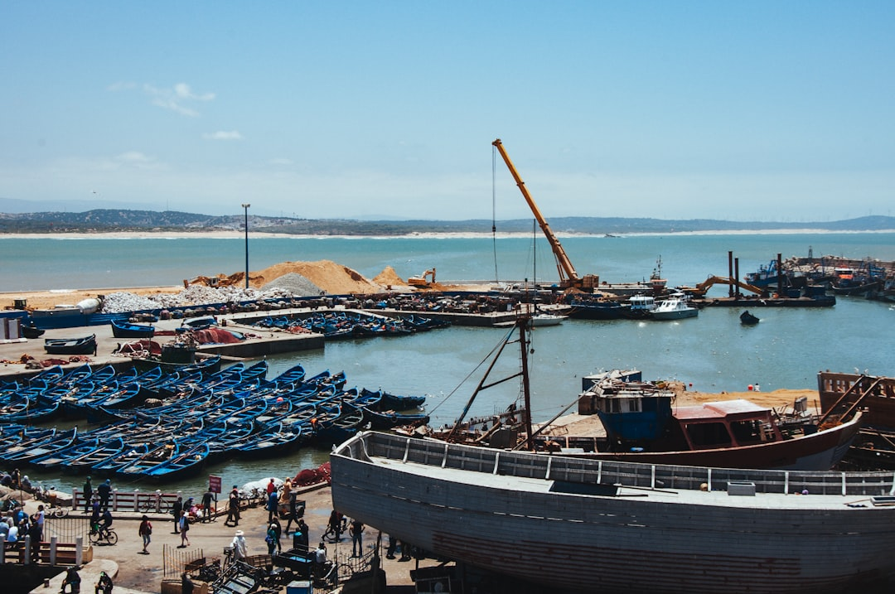

IMPACT ON PORTS
LOGISTICAL CHALLENGES
Tariffs disrupt supply chains, causing delays. Ports must adapt to changing trade regulations and compliance, which may require additional resources.
ECONOMIC EFFECTS
Tariffs can increase shipping costs, impacting port profitability. Higher tariffs can lead to reduced cargo volumes and changes in shipping routes.

Slide 7
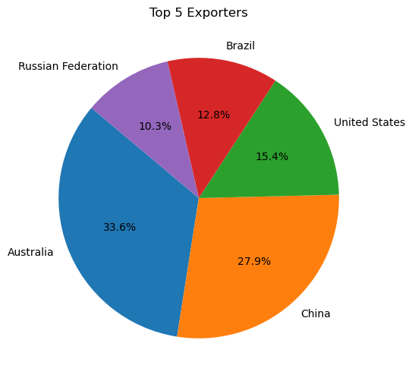
Top 5 Exporters on an Export Value Basis
As depicted in the Pie Chart, Australia and China are the largest exporters in the world from a port standpoint.

Slide 8
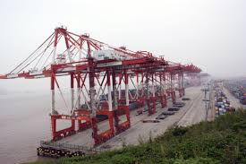
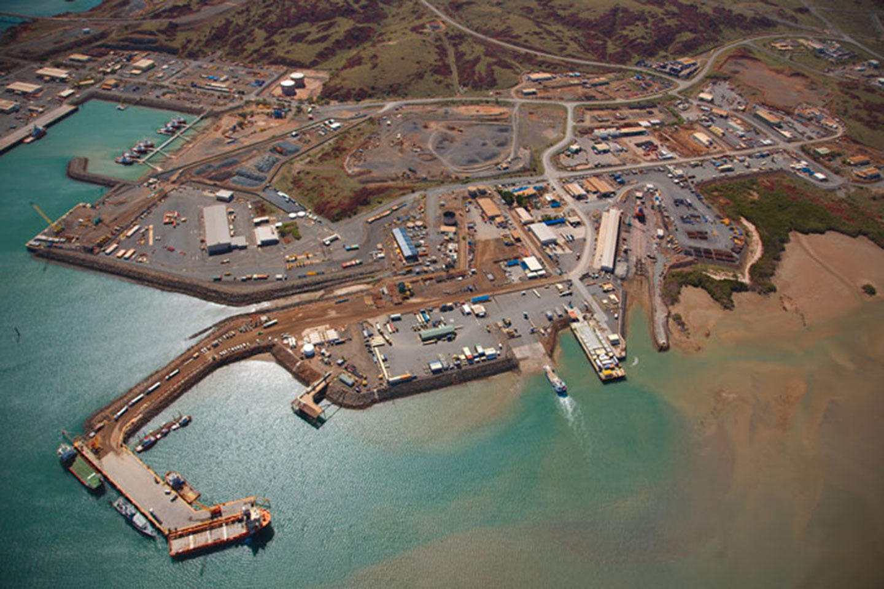
What Does the US Purchase form the Top Two Exporters
Australia
Agricultural products
In 2021, agricultural products were the top commodity sector imported from Australia, making up 28.5% of the total imports
Stone, glass, metals, and pearls
In 2021, stone, glass, metals and pearls made up 18.4% of the total imports from Australia
Chemicals, plastics, rubber, and leather goods
In 2021, chemicals, plastics, rubber, and leather goods made up 12.9% of the total imports from Australia
China
Machinery and mechanical appliances
In 2022, this sector accounted for 46.4% of all U.S. imports from China.
Furniture, bedding, lamps, toys, games, sports equipment, paint, and other miscellaneous manufactured items
In 2021, this sector was the main source of U.S. imports from China.
Chemicals, plastics, rubber, and leather goods
In 2022, this sector accounted for 12.0% of all U.S. imports from China.

Slide 9
ECONOMIC CONSEQUENCES
The economic impacts of tariffs on major international ports are significant. Changes in trade volume can affect local economies, employment, and port infrastructure investments.
PORT | ECONOMIC IMPACT | TRADE VOLUME CHANGE
Port of Los Angeles | -$200M | -15%
Rotterdam Port | -$150M | -10%
Singapore Port | -$120M | -5%
Hamburg Port | -$100M | -12%

Slide 10
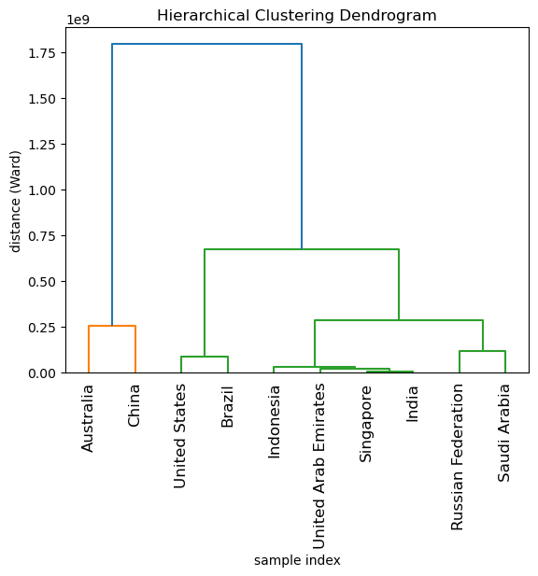
Insights
Australia is larger exporter than expected.
The US is more on par with Brazil as it pertains to Export values.
The impact the tariffs on China goods would be significant.

Slide 11
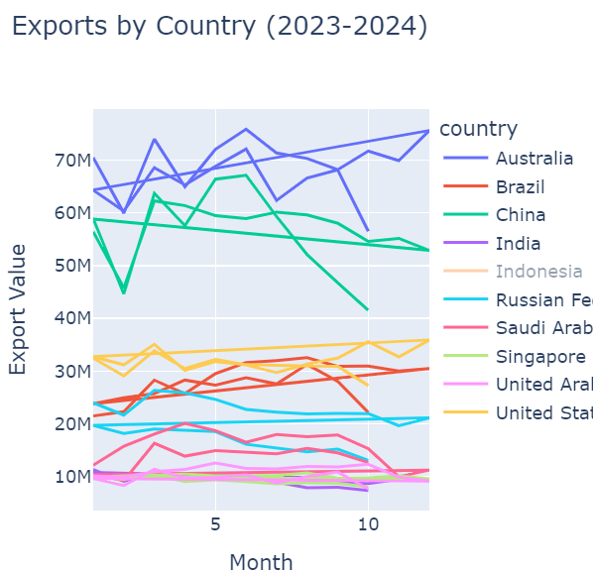
Top Exporters 2023-2024
As depicted in the line chart, Australia and China has remain amongst the top exports in the world. In comparison US is middle within the top 5.

Slide 12

MITIGATION STRATEGIES
Offering additional services can help ports offset losses from tariffs. This may include logistics support, warehousing, and value-added services to remain competitive.
OPERATIONAL EFFICIENCY
Ports can streamline operations to reduce costs and maintain profitability despite tariffs. Investments in technology and better logistics are crucial.

Slide 13
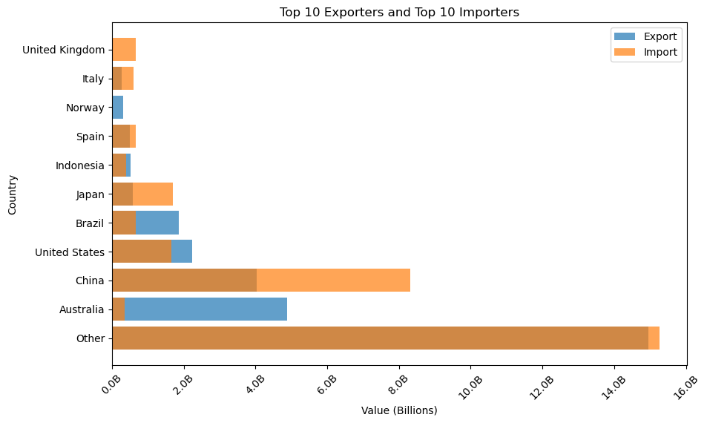

Slide 14
Challenges
Had to pivot on the project topic several times due to data availability issues.
Dataset was too large for my device which prevented certain visualizations.
Had to select less sophisticated visualizations due to needed data attributes were unavailable for certain visuals
Consolidating this topic into feasible presentation length

Slide 15
References
Office of the US Trade Representative
https://ustr.gov/countries-regions/southeast-asia-pacific/australia#:~:text=U.S.%20goods%20and%20services%20trade,was%20%2427.1%20billion%20in%202022.
Port Watch
https://portwatch.imf.org/datasets/75619cb86e5f4beeb7dab9629d861acf_0/explore?showTable=true
Polifact
https://www.politifact.com/article/2024/dec/02/can-donald-trump-enact-tariffs-on-his-own-and-can/
Bureau of Industry and Security
https://www.bis.doc.gov/index.php/documents/technology-evaluation/ote-data-portal/country-analysis/2998-2021-statistical-analysis-of-u-s-trade-with-australia/file#:~:text=In%202021%2C%20of%20$12.5%20billion,and%20Leather%20goods%20(12.9%25).

Slide 16
Q&A

